Slide 1
NLTK
Dr Mehreen Alam
Prof Ahmad Raza Shahid
Lecture 2

Slide 2
Contents
Tokenizing
Filtering Stop Words
Stemming
Tagging Parts of Speech
Lemmatizing
Using Named Entity Recognition (NER)
Using a Concordance
Making a Dispersion Plot
Making a Frequency Distribution
Finding Collocations

Slide 3
NLTK
Library suite:
that contains libraries and programs for statistical language processing.
Open-source python modules for applying statistical nlp
one of the most powerful NLP libraries
NLTK Dataset:
many datasets available that you need to download to use.
examples are stopwords, gutenberg, framenet_v15, large_grammars.

Slide 4
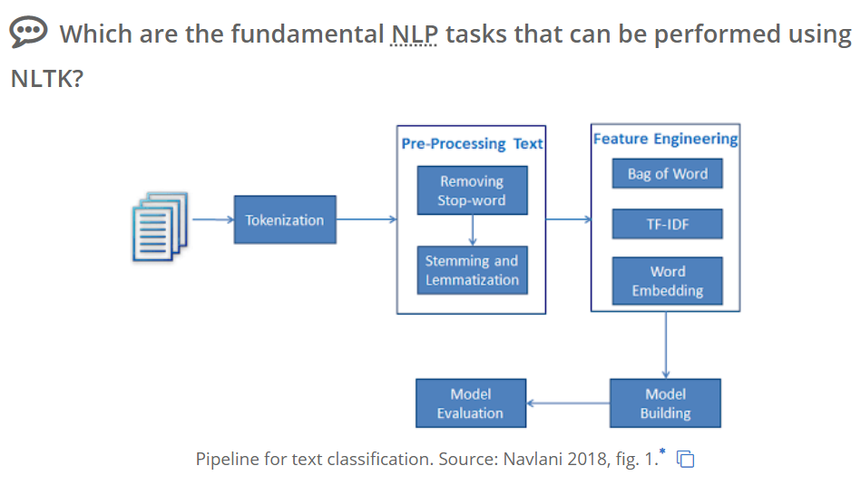

Slide 5
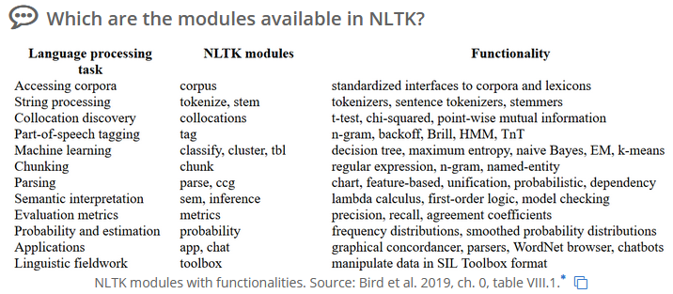
Modules available in NLTK
Complete module index is available at: https://www.nltk.org/py-modindex.html

Slide 6
Disadvantages
Doesn’t apply semantic analysis
NLTK lacks neural network models or word embeddings
Slow

Slide 7


Slide 8
Tokenizing
Word
Sentence
>>> from nltk.tokenize import sent_tokenize, word_tokenize
>>> example_string = """
... Muad'Dib learned rapidly because his first training was in how to learn.
... And the first lesson of all was the basic trust that he could learn.
... It's shocking to find how many people do not believe they can learn,
... and how many more believe learning to be difficult."""

Slide 9

>>> sent_tokenize(example_string)
["Muad'Dib learned rapidly because his first training was in how to learn.",
'And the first lesson of all was the basic trust that he could learn.',
"It's shocking to find how many people do not believe they can learn, and how many more believe learning to be difficult.“
>>> word_tokenize(example_string)

Slide 10
Filtering Stop Words
>>> nltk.download("stopwords")
>>> from nltk.corpus import stopwords
>>> from nltk.tokenize import word_tokenize
>>> worf_quote = "Sir, I protest. I am not a merry man!"
>>> words_in_quote = word_tokenize(worf_quote)
>>> words_in_quote
['Sir', ',', 'protest', '.', 'merry', 'man', '!']
>>> stop_words = set(stopwords.words("english"))

Slide 11
Filtering Stop Words
>>> filtered_list = []
>>> for word in words_in_quote:
... if word.casefold() not in stop_words:
... filtered_list.append(word)
>>> filtered_list = [
... word for word in words_in_quote if word.casefold() not in stop_words
... ]
>>> filtered_list
['Sir', ',', 'protest', '.', 'merry', 'man', '!']

Slide 12
Stemming
text processing task in which you reduce words to their root
E.g. “helping” and “helper” share the root “help.”
allows to zero in on the basic meaning of a word rather than all the details of how it’s being used.
NLTK has more than one stemmer, but we’ll the Porter stemmer.

Slide 13
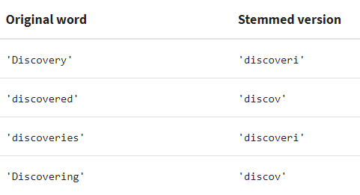
>>> from nltk.stem import PorterStemmer
>>> from nltk.tokenize import word_tokenize
>>> stemmer = PorterStemmer()
>>> string_for_stemming = """
... The crew of the USS Discovery discovered many discoveries.
... Discovering is what explorers do."""
>>> words = word_tokenize(string_for_stemming)
>>> stemmed_words = [stemmer.stem(word) for word in words]

Slide 14
Understemming and overstemming are two ways stemming can go wrong:
Understemming happens when two related words should be reduced to the same stem but aren’t. This is a false negative.
Overstemming happens when two unrelated words are reduced to the same stem even though they shouldn’t be. This is a false positive.

Slide 15
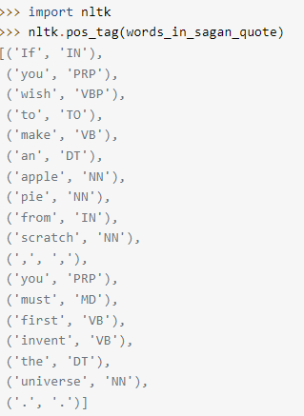
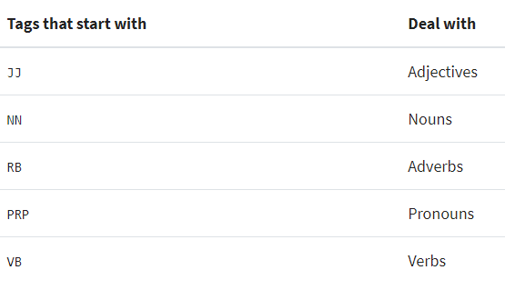
POS Tagging
task of labeling the words according to
their part of speech.
List of possible POS tags:
https://stackoverflow.com/questions/15388831/what-are-all-possible-pos-tags-of-nltk

Slide 16
Lemmatizing
A lemma is a word that represents a whole group of words
that group of words is called a lexeme.
E.g. “blending” not found in dictionary, you’ll find “blend”
“blend” is the lemma, and “blending” is part of the lexeme.
When ou lemmatize a word, you are reducing it to its lemma.

Slide 17
>>> from nltk.stem import WordNetLemmatizer
>>> lemmatizer = WordNetLemmatizer()
>>> lemmatizer.lemmatize("scarves")
'scarf'
>>> string_for_lemmatizing = "The friends of DeSoto love scarves."
>>> lemmatized_words = [lemmatizer.lemmatize(word) for word in words]
>>> lemmatized_words
['The',
'friend',
'of',
'DeSoto',
'love',
'scarf',
'.'

Slide 18
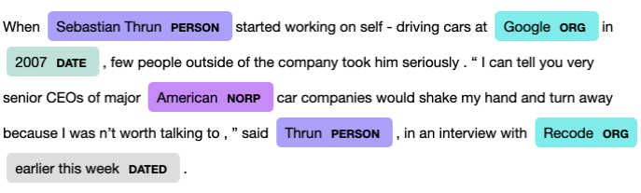
Named Entity Recognition
Named entities are noun phrases
that refer to specific locations, people, organizations, and so on.
you can find the named entities in your texts and also determine what kind of named entity they are.

Slide 19
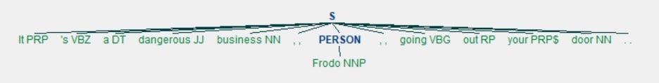
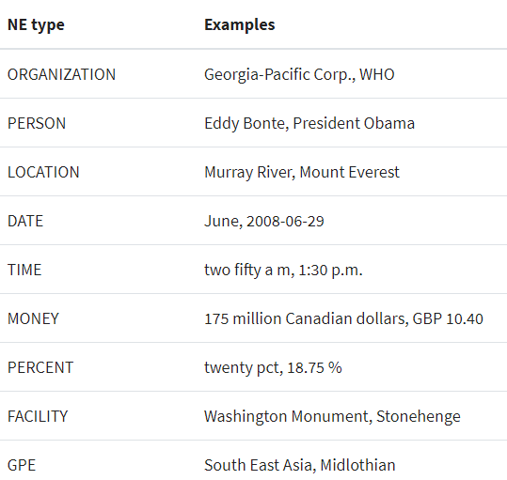
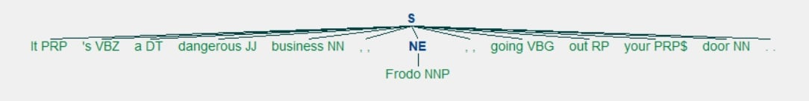
>>> nltk.download("maxent_ne_chunker")
>>> nltk.download("words")
>>> tree = nltk.ne_chunk(lotr_pos_tags)
>>> tree.draw()

Slide 20
Collocations & Bigrams/trigrams
>>> list(bigrams(['more', 'is', 'said', 'than', 'done']))
[('more', 'is'), ('is', 'said'), ('said', 'than'), ('than', 'done')]
import nltk
text = “Guru99 is a totally new kind of learning experience.”
Tokens = nltk.word_tokenize(text)
output = list(nltk.trigrams(Tokens))
print(output)
[('Guru99', 'is', 'totally'), ('is', 'totally', 'new'), ('totally', 'new', 'kind'), ('new', 'kind', 'of'), ('kind', 'of', 'learning'), ('of', 'learning', 'experience'), ('learning', 'experience', '.')]

Slide 21
nltk.download(‘gutenberg’)
files = nltk.corpus.gutenberg.fileids()
Print(files)
emma = nltk.corpus.gutenberg.words('austen-emma.txt‘)
from nltk import FreqDist
frequency_distribution = FreqDist(emma)
import pandas as pd
pd.DataFrame(list(frequency_distribution .items()), columns = ["Word","Frequency"])

Slide 22
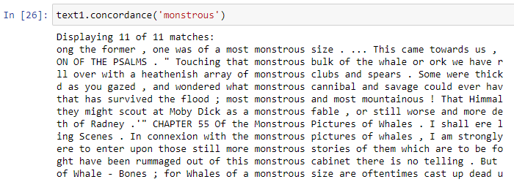
Using a Concordance

Slide 23
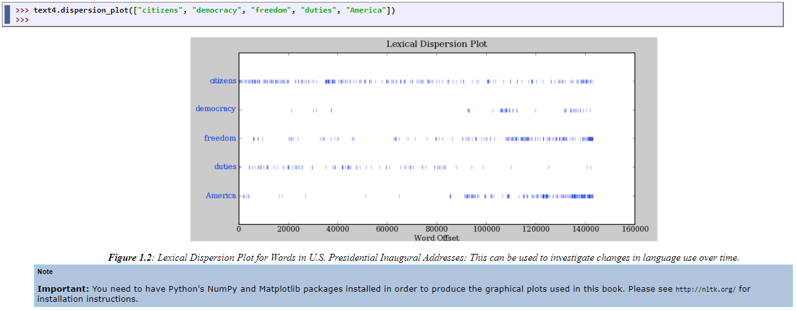
Making a Dispersion Plot

Slide 24
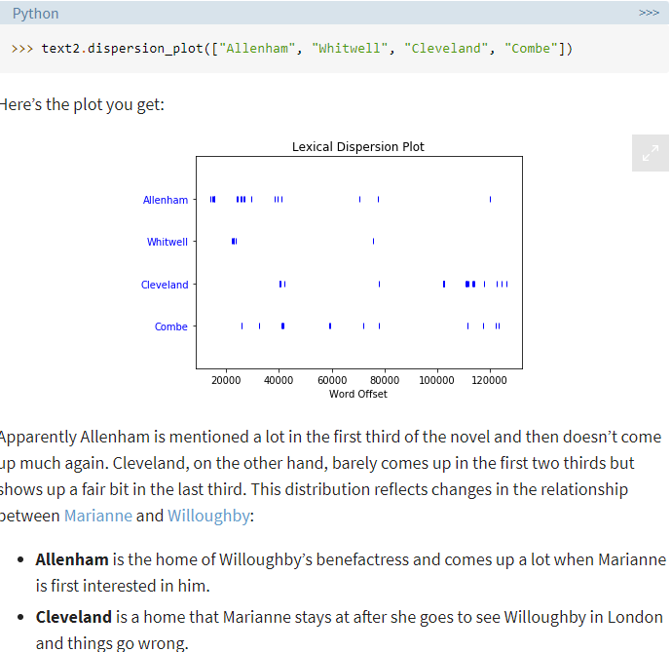

Slide 25
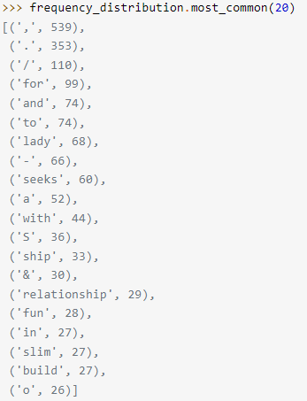
Making a Frequency Distribution
>>> from nltk import FreqDist
>>> frequency_distribution = FreqDist(text8)
>>> print(frequency_distribution)
<FreqDist with 1108 samples and 4867 outcomes>

Slide 26
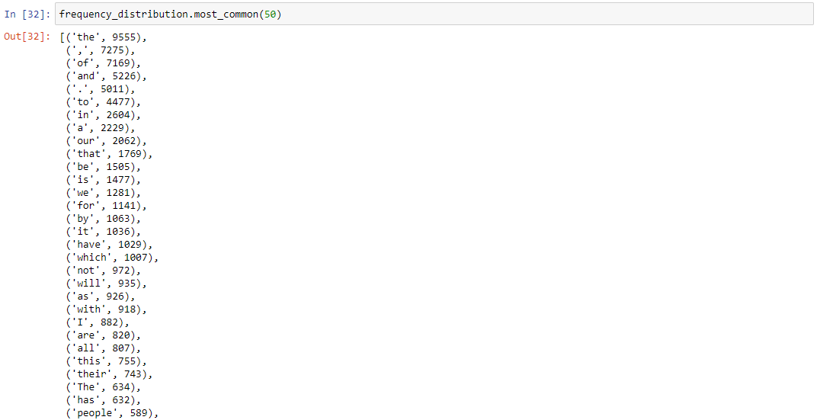
FreqDist continued

Slide 27
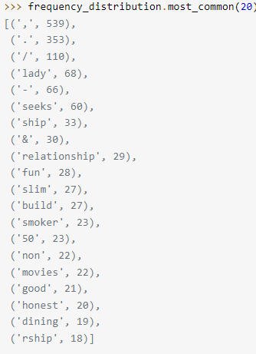
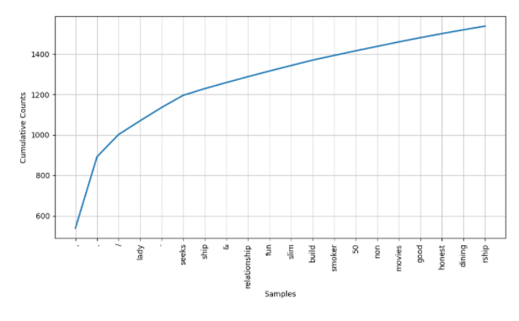
>>> meaningful_words = [
... word for word in text8 if word.casefold() not in stop_words
... ]
>>> frequency_distribution = FreqDist(meaningful_words)
>>> frequency_distribution.plot(20, cumulative=True)

Slide 28
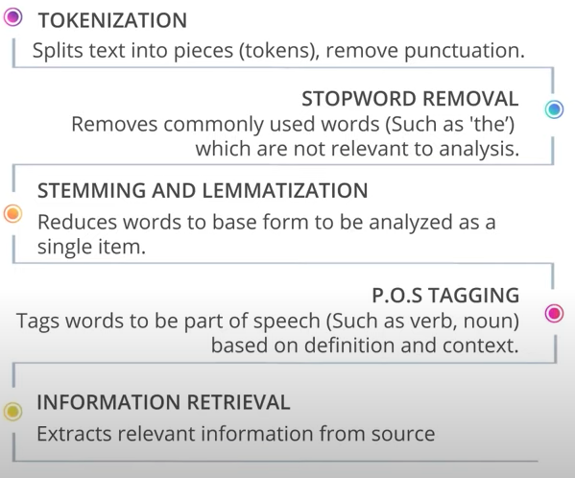
NLP Process Workflow

Slide 29
Disadvantages of nltk
For sentence tokenization, NLTK doesn't apply semantic analysis.
Unlike Gensim, NLTK lacks neural network models or word embeddings.
NLTK is slow, whereas spaCy is said to be the fastest alternative.
NLTK was created educational purpose, optimized runtime performance was never a goal.
Can be speeded up in its execution using Python's multiprocessing module.
Matthew Honnibal, the creator of spaCy, noted that NTLK has lots of modules but very few (tokenization, stemming, visualization) are actually useful.
Often NLTK has wrappers to external libraries and this leads to slow execution.
The POS tagger was terrible, until Honnibal's averaged perceptron tagger was merged into NLTK in September 2015.
In general, NLP is evolving so fast that maintainers need to curate often and throw away old things.

Slide 30
Link to nltk website
Simple work that can done:
https://www.nltk.org/

Slide 31
Useful Links
https://realpython.com/nltk-nlp-python
https://www.guru99.com/nltk-tutorial.html
https://www.guru99.com/nlp-tutorial.html
https://www.guru99.com/download-install-nltk.html
https://www.guru99.com/tokenize-words-sentences-nltk.html
https://www.guru99.com/pos-tagging-chunking-nltk.html
https://www.guru99.com/stemming-lemmatization-python-nltk.html
https://www.guru99.com/wordnet-nltk.html
https://www.guru99.com/word-embedding-word2vec.html
https://www.guru99.com/seq2seq-model.html
Also look at:
https://www.datacamp.com/community/tutorials/text-analytics-beginners-nltk
https://www.nltk.org/book/ch01.html

